Slide 1
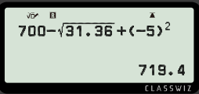


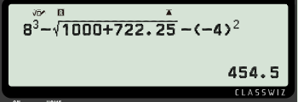

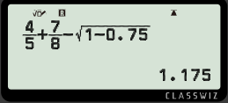

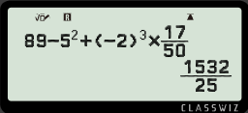

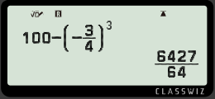

Using your calculator efficiently
Task A: Negatives and operations
1) Work out the following with your scientific calculator. Give your answer in decimal form.
a)
b)
c)
2) Work out the following with your scientific calculator. Give your answer in fractional form.
a)
b)
c)

Slide 2
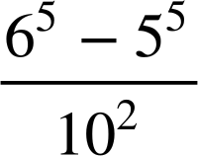
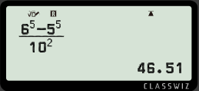
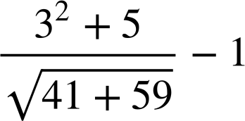
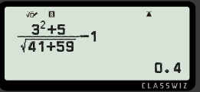
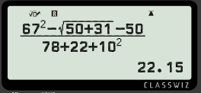
Using your calculator efficiently
Task B: Brackets and operations
1) Work out the following with your scientific calculator. Give your answer in decimal form.
a)
b)
c)
Mathematics in Education and Industry
v2.2

